Slide 1

LEAD SCORING CASE STUDY
By
Mousham Kuri

Slide 2
Problem Statement
An education company named X Education sells online courses to industry professionals. On any given day, many professionals who are interested in the courses land on their website and browse for courses.
The company markets its courses on several websites and search engines like Google. Once these people land on the website, they might browse the courses or fill up a form for the course or watch some videos. When these people fill up a form providing their email address or phone number, they are classified to be a lead. Moreover, the company also gets leads through past referrals. Once these leads are acquired, employees from the sales team start making calls, writing emails, etc. Through this process, some of the leads get converted while most do not. The typical lead conversion rate at X education is around 30%.
Now, although X Education gets a lot of leads, its lead conversion rate is very poor. For example, if, say, they acquire 100 leads in a day, only about 30 of them are converted. To make this process more efficient, the company wishes to identify the most potential leads, also known as ‘Hot Leads’. If they successfully identify this set of leads, the lead conversion rate should go up as the sales team will now be focusing more on communicating with the potential leads rather than making calls to everyone. A typical lead conversion process can be represented using the following funnel:
Lead Conversion Process - Demonstrated as a funnel Lead Conversion Process - Demonstrated as a funnel As you can see, there are a lot of leads generated in the initial stage (top) but only a few of them come out as paying customers from the bottom. In the middle stage, you need to nurture the potential leads well (i.e. educating the leads about the product, constantly communicating etc. ) in order to get a higher lead conversion.
X Education has appointed you to help them select the most promising leads, i.e. the leads that are most likely to convert into paying customers. The company requires you to build a model wherein you need to assign a lead score to each of the leads such that the customers with higher lead score have a higher conversion chance and the customers with lower lead score have a lower conversion chance. The CEO, in particular, has given a ballpark of the target lead conversion rate to be around 80%.

Slide 3

Approach of the Analysis
We started by analyzing the dataset.
Added the missing data with median values for numerical and mode values for categorical.
Converted all the “Yes” and “No” to 1 and 0 respectively.
Added dummy variables for the categorical variables.

Slide 4
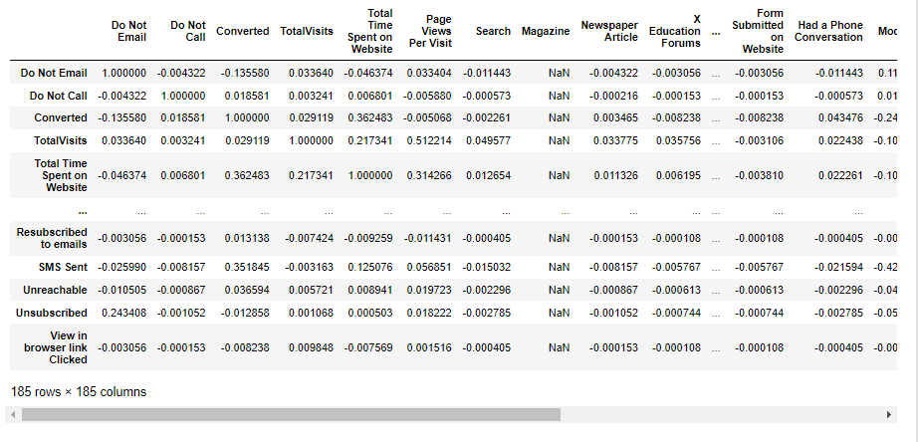
Correlation
We split the dataset into train and test set and perform Normalization on the features.
Normalization is required to keep all the variables in same scale which will help us in computing more efficiently and also fixes the outliers.
We also checked the correlation of the dataset using a heat map and “Corr” function. There are some high correlation values that will get dropped during the RFE process.

Slide 5
Building a Model- RFE
We build a model with all the features included and found there are many insignificant variables present in our model.
We need to drop them, but we cannot do that one by one as it is time consuming and is not efficient.
Hence we start with “RFE” method to deduct those insignificant variables. We choose only 15 variables.
We started our model building with 15 variables and went on dropping variables one by one until we reach the point where the model is having all the significant variables.
We evaluated our Model by first predicting it. We created new dataset with original converted values and the prediction values.

Slide 6
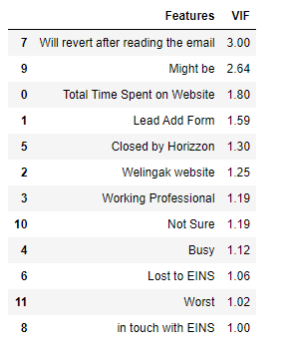
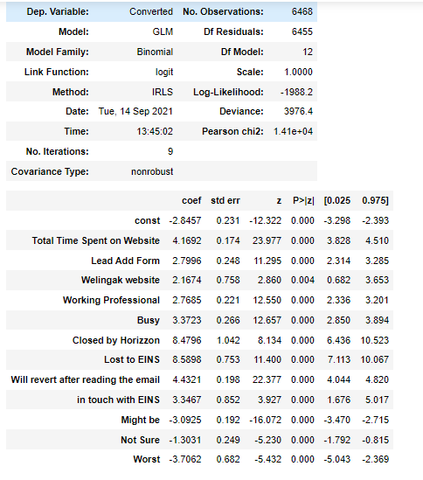
Final Model Visualization with VIF

Slide 7
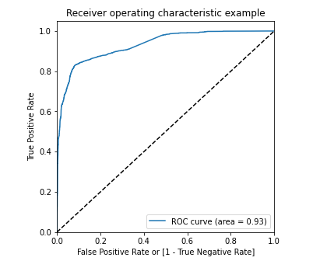
Evaluating the Model
After building the final model making prediction on train set, we created the ROC curve to find the model stability with area under the curve. As we can see from the graph plotted on the right side the area score is 93% which is a great score.
Our graph is leaned towards the left side of the border which means we have good accuracy as well.

Slide 8
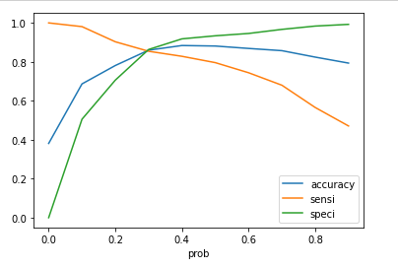
Finding the Optimal Cutoff Point
Now, we have created range of points for which we will find the accuracy, sensitivity and specificity for each points and analyze which point to chose for probability cutoff.
We found that at 0.3 point all the scores of accuracy, sensitivity and specificity are in a close range which is the ideal point.
To verify our answer we plotted a line graph and we check the meeting point of accuracy, specificity and sensitivity. It turns out to be meeting on 0.3 thus making it the optimal probability cutoff point

Slide 9
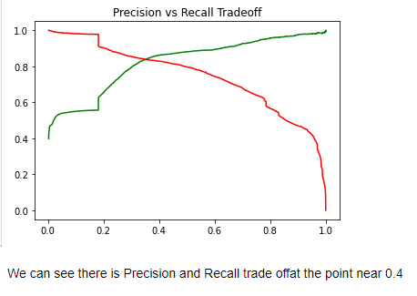
Precision and Recall
Using the cutoff point we create a new column in our final dataset for predicting the outcomes.
We perform a different evaluation which is by checking Precision and Recall. These inform us how our model behaves thus plays a very important role in building the model more business oriented.
The Precision and the Recall values for the model is 90% and 86% respectively.
Based on our business prospective, Recall plays an important role as we don’t want to leave out any hot lead which are willing to get converted.
As the Precision increases Recall decreases , thus there is a tradeoff between the 2 and we can check it using a graph.
The meeting point of the tradeoff is near 0.4.

Slide 10
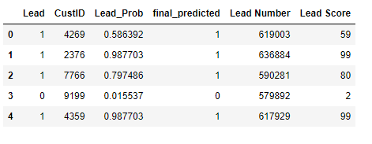
Prediction on Test Set
We Normalize our test set data.
We predict the test set data and add it in a new dataframe.
We them find out the accuracy, precision, specificity and recall/ sensitivity for the test set. The accuracy is 86%, sensitivity is 87%, specificity is 86%, precision is 90% and recall is 86%.
Based on the test prediction which is in acceptable range our model is stable.
Lead score is created ion the test dataset to identify the hot leads.

Slide 11
Conclusion
Valuable insights:
The Accuracy, Precision and Recall/Sensitivity are showing promising scores in the test set which is as expected after looking the same for the train set data. The Recall is having a high score value based on the business needs.
In business terms this model has an ability to adjust with the companies' requirements in future.
Thus concludes that the model is in stable state.
Important features responsible for good conversion rate are:
Closed by Horizzon
Lost to EINS
Will revert after reading the email

Slide 12
Thank you

